Slide 1
GRASSROOTS PROGRAMME
ASPIRING AND INSPIRING
YOUTH LEADERS
Notes:
Welcome the participants to the programme
Introduce yourself
Introduce AIYL:
The AIYL programme is a partnership of 10 European organisations who have teamed up, with support from EU Erasmus+ sports funding, to create a youth leadership programme
Introduce the grassroot programme
AIYL will create two youth leadership programmes, the first of which is the grassroots leadership programme which is aimed at youth leaders to deliver locally. This grassroots programme is aimed at inspiring and upskilling local youth leaders and have them to action plan for their youth groups.
Mention IO3
AIYL will also create a long term youth leadership programme for participants across Europe that is aimed at youth leaders who are ready to make a next step toward a more senior function in the national or international sports world.

Slide 2
AIMS
Of the grassroots programme
To be determined by you based on your context.
Notes:
Now you’ve heard about the aims of AIYL and the grassroots project, these are the aims that I have set out for us this weekend:
To be decided by you prior to delivering or by the group itself

Slide 3
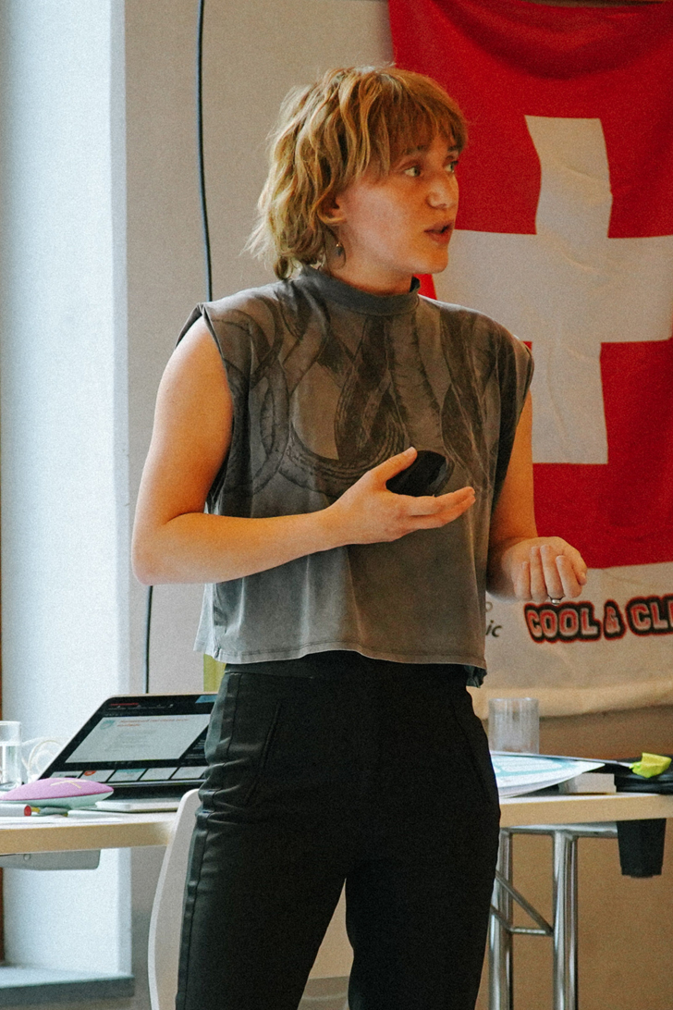
MODULE 1
Communication
Notes:
Module 1: Communication

Slide 4
Recognise the value of communication and how to communicate with different groups
Recognise the value of public speaking and how to improve your own
AIMS
By the end of this module you will:
Notes:
Aims:
Run through the aims of the module

Slide 5
Does not live in the country they were born in
Has never been on an airplane
Likes
Sushi
Can
Juggle
Left handed
Can speak another language
Plays a musical instrument
Has an older brother
Has a
pet
Goes to university
ICEBREAKER
Networking Bingo!
Has a nickname
Is a vegetarian
BINGO
Has an allergy
Born in October
Touch their nose with their tongue
Has a
phobia
Has size 10
feet
Is not on facebook
Bites their fingernails
Favourite food is pizza
Wears contact lenses
Has played a prank on someone else
Has seen the same movie 3 or more times
Can touch their toes
Notes:
Icebreaker: Networking bingo!
Using the bingo card provided in the resource pack, get participants to go around introducing themselves while trying to fill out their bingo card.
Players must put initials of the other participants on each of the squares they tick off.
You are welcome to tweak the rules based on the size of the group – e.g. get a line, the whole block, not allowed two from the same person in a row…

Slide 6
ICEBREAKER
Getting to know you
(show and tell)
Notes:
Extra Icebreaker: Getting to know you
If the group is new to one another and you feel like you might need another icebreaker, the Getting to Know You icebreaker is a good place to start
e.g. Getting to know you (Show and Tell) One by one the players say their names and make a gesture or movement of something they like to do (e.g, My name is Omar and I like to play baseball - then he makes the motion of swinging a bat). The next player to the left then repeats that name and adds their own, etc.
There are more icebreakers in the accompanying resources
Hide this slide if you don’t need it

Slide 7
WHICH SOCIAL MEDIA
PLATFORMS DO YOU USE?
Notes:
Activity: Stand up or Sit down
Stand-up sit down for which social media sites the youth leaders use
Instagram, YouTube, Facebook, Twitter, TikTok, Snapchat, LinkedIn add more to this list if you like

Slide 8
WHICH SOCIAL MEDIA PLATFORMS DOES YOUR YOUTH ORGANISATION USE?
Notes:
Activity: Stand up or Sit down
Stand-up sit down for which social media sites their youth organisation uses
Instagram, YouTube, Facebook, Twitter, TikTok, Snapchat, LinkedIn
If there is not yet a youth organisation, change the question to “Which social media platforms should a/your youth organisation used?”

Slide 9
Which channels?
What do you post?
What is the purpose of these?
What do you want to achieve?
What can you do better?
What is your audience?
COMMUNICATION
SELF-ASSESSMENT
(for your youth organisation)
Notes:
Activity: Communication self-assessment
In small groups (2-4) use post-it notes, whiteboards or flipchart paper to answer these questions about how your youth organisation communicates with the outside world.
Once the groups have spoken, bring all together and share thoughts. Then discuss what the group can do better.
If there is not a youth organisation, use this to plan what the group will do to communicate. Communicating to future members and expanding the group for example.

Slide 10
WHEN SUDDENLY…
Notes:
Activity: When suddenly…
Start a story with a sentence that ends in WHEN SUDDENLY…
The next person then adds their own sentence that ends in WHEN SUDDENLY…
Keep going around the circle until everyone has added

Slide 11
Take your time
Voice projection
Let your personality come through
Know your audience
PUBLIC
SPEAKING
Notes:
Public speaking
There may be some points as a youth leader where you will have to engage in public speaking, we will quickly run through some tips that you can apply to any scenario.
Go through these public speaking tips:
Take your time
Voice projection
Let your personality come through
Know your audience

Slide 12
WHEN SUDDENLY…
Round 2
Notes:
Activity: When suddenly…
Run the activity again but this time thinking about the public speaking tips
Start a story with a sentence that ends in WHEN SUDDENLY…
The next person then adds their own sentence that ends in WHEN SUDDENLY…
Keep going around the circle until everyone has added

Slide 13
WHAT IS THE ONE
THING THAT YOU WILL
DO AFTER THIS SESSION?
REFLECTION
Think, pair and share
Notes:
Reflection: Think pair and share
Using the think, pair and share strategy get them to discuss what they have learnt from this session and what they are going to do after this session
Get each participant to commit to one thing that they will do for their organisation after this session

Slide 14
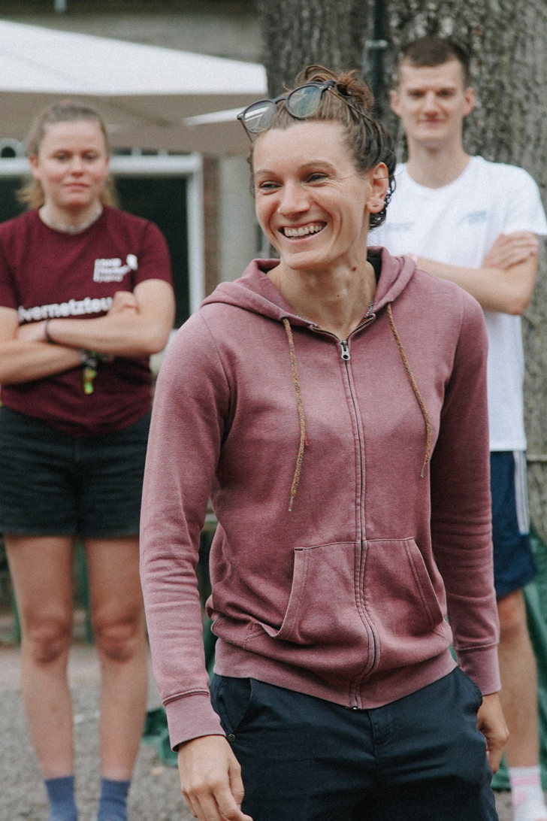
MODULE 2
Leadership
Notes:
Module 2: Leadership

Slide 15
Understand and apply the knowledge of leadership styles
Ability to self-reflect on their strengths, weakness and personal leadership style
AIMS
By the end of this module you will:
Notes:
Aims:
Run through the aims of the module

Slide 16
WHAT MAKES A GOOD LEADER?
Notes:
Activity: What makes a good leader?
Split into smaller groups and discuss what makes a good leader.
Then share their ideas and put on a flipchart/whiteboard.

Slide 17
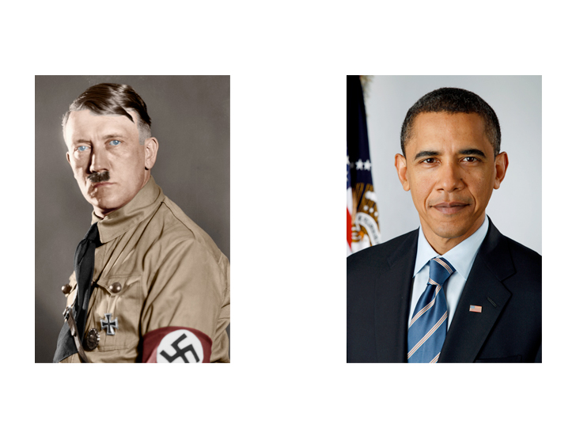
WHAT IS THE DIFFERENCE BETWEEN
THESE TWO LEADERS?
Notes:
Activity: Different leadership styles
Think. Pair. Share. What are the main differences between these two leaders?

Slide 18
ACTIVITY
Leadership styles
Notes:
Activity: Leadership styles
Split into small groups
Give each group an envelope which contains leadership styles and their definitions
Each group should match the leadership style to its definition

Slide 19
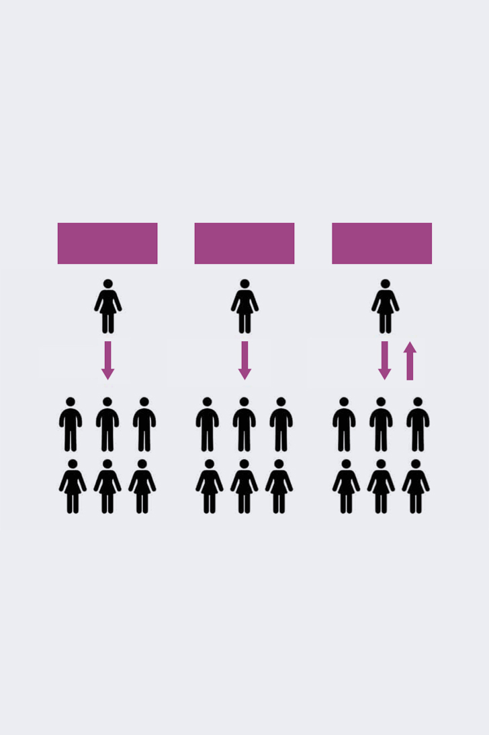
AUTOGRATIC
LAISSEZ-FAIRE
DEMOCRATIC
ACTIVITY
What sort of leader are you and what
skills make you a good leader?
What do you think we should do?
Do this!
Do this or that as you see fit
Notes:
Activity: What sort of leader are you?
Think. Pair. Share.
Based on the definitions from the last activity, what sort of leader do you think you are?

Slide 20
Strategic thinking
Teamwork
Collaboration
Communication
Mentoring
Support
Openness
Adaptability
Decision maker
LEADERSHIP
SKILLS AND QUALITIES
Notes:
Leadership skills and qualities:
Run through the skills and qualities that make a good leader - hopefully they will have listed some of these skills

Slide 21
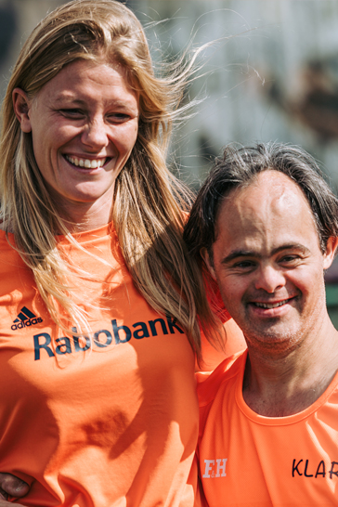
ACTIVITY
Role models
Notes:
Activity: Role Models
Think. Pair. Share.
Who are your role models and why?
What qualities do they have?
Are they a leader?
If you cannot think of a role model, think of who others people consider to be a role model and what their qualities are

Slide 22
Get out of your comfort zone
Study leaders that you look up to
Encourage yourself
Take advice from other leaders
Research and gather resources
Create a plan
BECOME
A LEADER
Notes:
Becoming a leader:
Talk them through the tips that you can use to become a good leader
We have already started this process, by pushing you out of your comfort zone in some of these activities and by getting you to think about your role models

Slide 23
SWOT ANALYSIS
Business or individual
Strengths
Weaknesses
Opportunities
Threats
What do you do well?
What unique resources can you draw on?
What do others see as your strengths?
Where can you improve?
What do competitors do better?
What resources do you lack?
What market opportunities are present?
How can you make the most of your strengths?
What trends can you take advantage of?
What is your competition currently doing?
Do your weaknesses expose your business
What threats can hurt your business?
Notes:
Activity: SWOT Analysis (Business or individual)
Pick a business (e.g. McDonalds)
Each corner of the room represents each SWOT element – use flipchart and notes to detail how your chosen business fits into it – then rotate

Slide 24
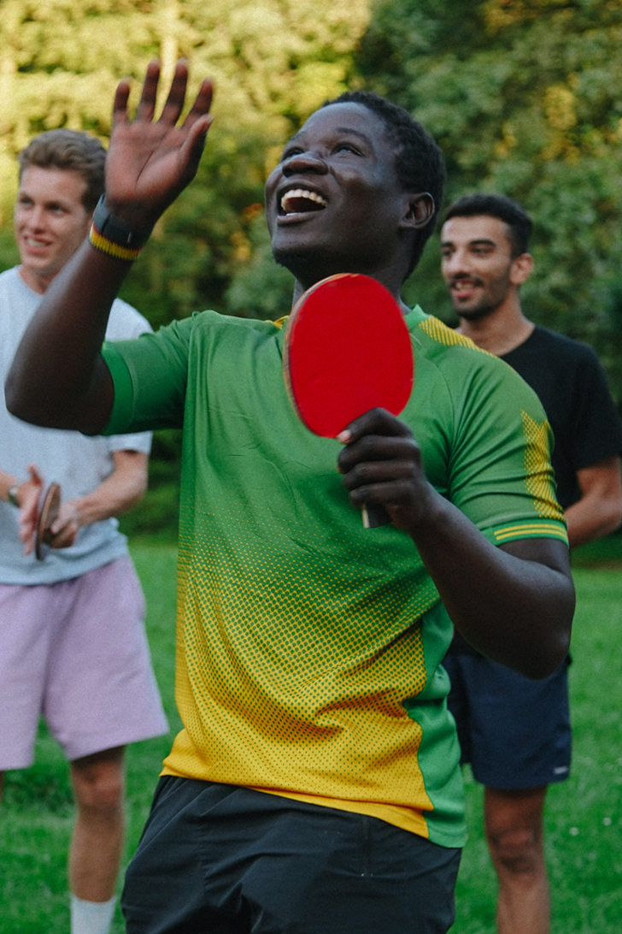
ACTIVITY
People management
Notes:
Activity: People management
Split into two groups, and have each group select a leader
The leader must line up their group in height order
Then the leaders should switch and complete line them up without communicating verbally
Discuss the differences in the two tasks and what you can learn from them.
Hint: The effectiveness of communication and how you need to nurture your leadership style to the individuals in front of you

Slide 25
“If your actions inspire others to dream more, learn more, do more and become more, you are a leader”
John Quincy Adams
Notes:
Inspirational quote to finish the module

Slide 26
MODULE 3
Governance
Notes:
Module 3: Name TBC

Slide 27
Have the ability to utilise a SWOT analysis to reflect on their youth organisation
Understand how to mitigate risks to your youth organisation
AIMS
By the end of this module you will:
Notes:
Aims:
Run through the aims of the module

Slide 28
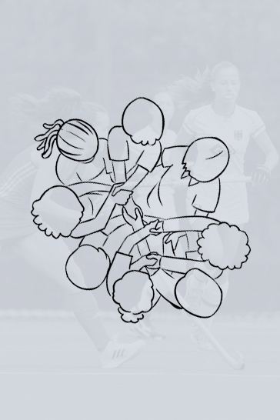
ICEBREAKER
The human knot
Notes:
Icebreaker: The Human Knot
Use an icebreaker from the accompanying resource booklet
E.g. Human Knot: Stand the group in a circle, shoulder to shoulder. Everyone places their hands into the circle and grasps the hands of two different people. Without letting go of the other people’s hands, the group must unravel the knot until they are in a big circle again.

Slide 29
Strengths
Weaknesses
SWOT ANALYSIS
Your youth organisation
Threats
Opportunities
Notes:
SWOT Analysis: of your youth organisation
In the four corners of the room there is a piece of flipchart paper with the headings of Strengths, Weaknesses, Opportunities and Threats
Split into four groups
Using post-it notes, you are going to think about the SWOT of your youth organisation
Each group will take 5 mins on each one then move around the room to the next heading, adding to what is there already
The groups moving around the room should be at least pairs so if the group is small, not all flipchart pages have to be used at the same time.
If you do not have a youth organisation yet, have them think about the group they are looking to form, or the group in the room at that point. E.g. Strengths: We are new so can go in any direction we wish. Threats: We don’t have much buy in as we are brand new. Weaknesses: Not many members because we are new.

Slide 30
SWOT ANALYSIS
Your youth organisation
Strengths
Weaknesses
Opportunities
Threats
What do you do well?
What unique resources can you draw on?
What do others see as your strengths?
What have been recent successes? Why were they successful?
Where can you improve?
Where are you lacking resources?
In what areas do you need more support/training?
What external opportunities are you aware of? How can you make the most of them?
How can you turn your strengths into opportunities?
What can you do that you aren’t already?
What external risks to the organisation?
Are we competing with others?
Will your strengths last?
Notes:
SWOT Analysis: of your youth organisation
If the group is struggling, use the prompt questions on this slide to help them think

Slide 31
RISK ASSESSMENT ACTIVITY
IMPACT
Minor
Moderate
Major
Improbable
Unlikely to occur
Possible
Will likely occur
LIKELIHOOD
Probable
Will occur
Notes:
Activity: Risk Assessment
Explain that it is important to understand the risks to any group or organisation and how to mitigate them. The first step is to assess these risks to see how likely they are and how much impact they would have.
Using the post-it notes from the threat section of the SWOT analysis
Place them on a chart working out their likelihood and the impact they would have on the youth organisation
Do this in one big group and have those who put the post it note there in the first place elaborate if needed

Slide 32
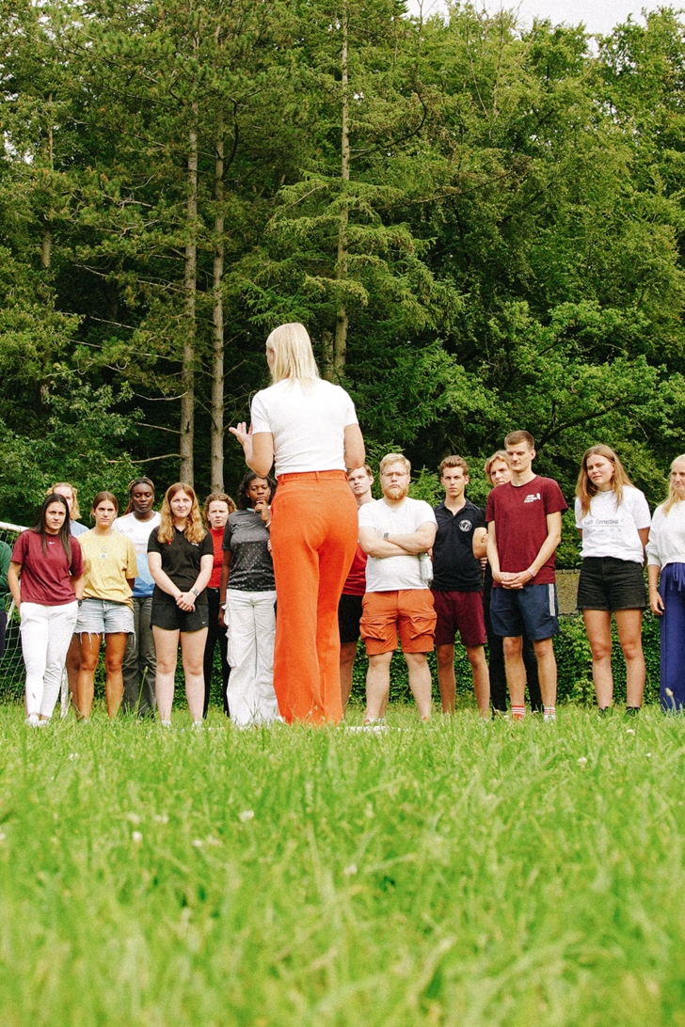
RISK ASSESSMENT ACTIVITY
Can you draw on your strengths to mitigate this?
Do you need external support to mitigate this?
Whose responsibility is managing this threat?
What can you do to mitigate this threat?
Notes:
Activity: Risk management
Now that we understand the likelihood and the impact that these risks would have on the youth organisation, we can think about how we will mitigate/deal with these risks.
Start with the most impactful and most likely risks, as they should be dealt with first – the post-it notes in the top right corner.
Place post-it with the threat on another piece of paper
Create a brainstorm of ideas on how to combat this risk, use the prompt questions to help
This should be done in smaller groups, no bigger than 4 but can be done as a whole group if necessary

Slide 33
WHAT IS THE ONE
THING THAT YOU WILL
DO AFTER THIS SESSION?
REFLECTION
Notes:
Reflection: Think pair and share
Using the think, pair and share strategy get them to discuss what they have learnt from this session and what they are going to do after this session
Get each participant to commit to one thing that they will do for their organisation after this session

Slide 34
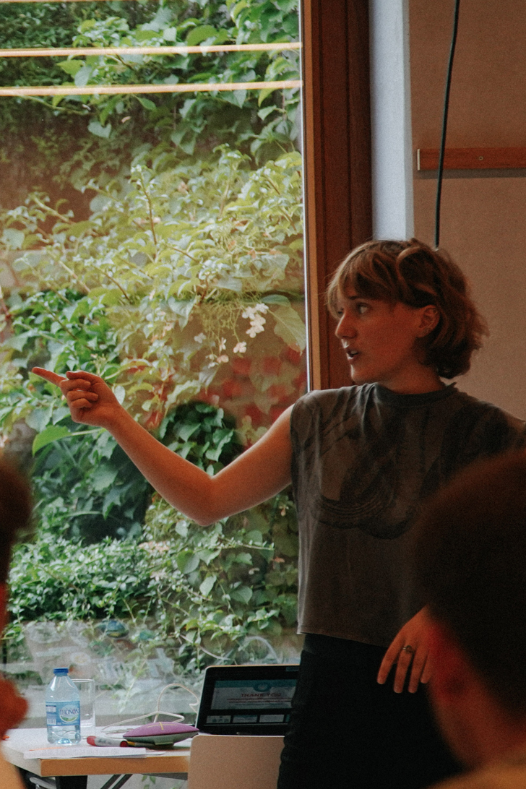
MODULE 4
Project management
Notes:
Module 4: Project Management

Slide 35
Know the key components of effective project management
Understand what impacts on the different components of project management and how to plan for them
Build a plan for a project/event you would like to organise.
AIMS
By the end of this module you will:
Notes:
Aims:
Run through the aims of the module

Slide 36
The discipline of initiating, planning, executing, controlling and closing the work of a team to achieve specific goals and to meet specific success criteria.
WHAT IS PROJECT MANAGEMENT?
Notes:
What is project management?
Ask the group this question and get responses through hands up.
Then give the group the above definition.

Slide 37
Vision
What do you want to achieve?
Action
KEY COMPONENTS
OF PROJECT
MANAGEMENT?
What are the steps needed to get you there?
Resources
What are the resources you need to achieve each step? e.g. people, money, equipment
Review/reflection
Did you achieve the vision? What would you do differently next time?
Notes:
Key components of project management
Run through the 4 key components of project management

Slide 38
FRISBEE
ACTIVITY
Lets have a go…
Vision
Get this Frisbee from A-B, you decide the rest…
Resources
You have a Frisbee and the people in
your group, that’s it!
Notes:
Activity: Frisbee
Split the group into half
Using the resources of a frisbee and the people in your group get the frisbee from A – B.
They decide where A and B are, they also decide if there are any other twists. E.g. doing it quickly, with the least number of throws, or even the most throws.
Once they have decided their vision, they must then think about their action

Slide 39
Review/reflection
Did you achieve the vision?
Did you adapt the vision?
What went well?
What would you do differently next time?
Resources
Notes:
Activity: Frisbee reflection
Now they have created their vision and actioned it, they must now reflect
Use the prompt questions to help them reflect
Once they have reflected as a group, they should feedback the whole process, from vision to reflection to the rest of the group

Slide 40
CREATE YOUR
ELEVATOR PITCH
You will have 3 minutes to present
your elevator pitch
Notes:
Activity: Elevator Pitch
Split into groups of 2-4
Each group will think of a project for the youth group – efforts to create a youth group, can be a project itself
The groups will then create a 3 minute elevator pitch
Imagine that you are presenting this to somebody from your national federation, or club, that would be responsible for supporting your in your project
We will go through the steps of project management together

Slide 41
In small groups come up with your own vision for something you would like to achieve in your youth organisation
What do you want to achieve?
What will be the impact of the project?
How will you demonstrate/promote what has actually been achieved?
SO WHAT IS
YOUR VISION?
Notes:
Activity: Elevator Pitch: Your vision

Slide 42
What do you need to complete the project?
People, equipment, facilities, funding or anything else you think is needed.
Include anything that you think not having would mean you couldn’t complete the project.
WHAT DO YOU NEED
TO GET THERE?

Slide 43
Think about how you will reflect on the project
What would make the project a success?
How will you measure this success?
WHAT MAKES IT
A SUCCESS?

Slide 44
PITCH TIME
You will have 3 minutes to present
your elevator pitch
Notes:
Activity: Elevator pitch
Each group gets three minutes to present their pitch
The other groups should have the chance to ask questions time for questions

Slide 45
WHAT IS THE ONE
THING THAT YOU WILL
DO AFTER THIS SESSION?
REFLECTION
Notes:
Reflection: Think pair and share
Using the think, pair and share strategy get them to discuss what they have learnt from this session and what they are going to do after this session
Get each participant to commit to one thing that they will do for their organisation after this session

